Slide 1
CSCI2520 Tutorial 7: Binary Tree & Mid 2 Review
Pan Zhenyu
zypan24@cse.cuhk.edu.hk
Slide Ack: modified based on the slides from Li Hui

Slide 2
Outline
Binary Tree Traversal
Find Successor in BST
Mid 2 review

Slide 3
Binary Tree Traversal
Traversal
Pre-order
In-order
Post-order
Preorder:
A B D C E G F H J
Inorder:
D B A E G C H F J
Postorder:
D B G E H J F C A
A
B
C
D
E
F
G
H
J

Slide 4
Binary Tree Reconstruction
Question: can you reconstruct the binary tree from its inorder/preorder/postorder traversal?
Or, if the inorder traversal of a binary tree is (B, A, C), what will it be?

Slide 5
Binary Tree Reconstruction
Both have inorder traversal (B, A, C)!
A
B
B
C
A
C

Slide 6
Exercise 1
Given the following information, try to reconstruct the original binary tree.
In-order:
K N C D I L H B J E M G K A F
pre-order:
H D N K C I L G E B J M F K A

Slide 7
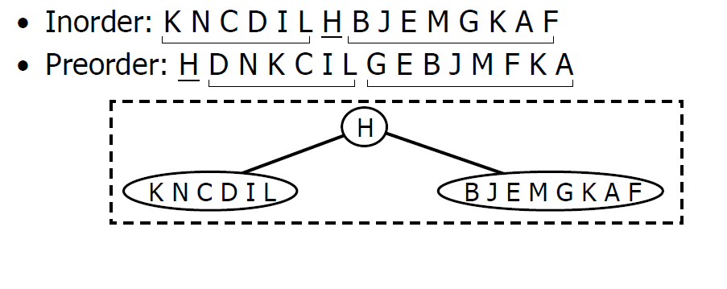
Binary Tree Reconstruction

Slide 8
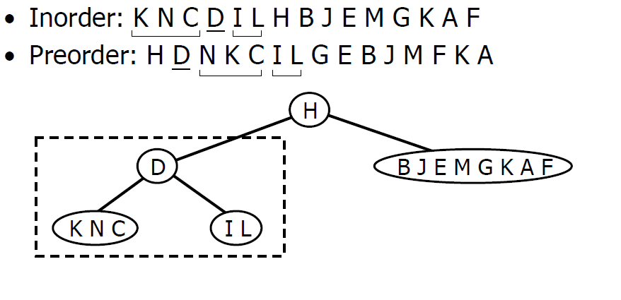
Binary Tree Reconstruction

Slide 9
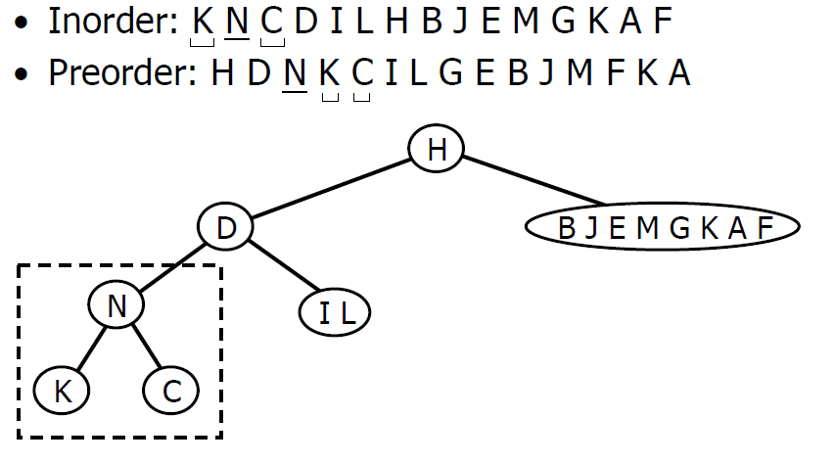
Binary Tree Reconstruction

Slide 10
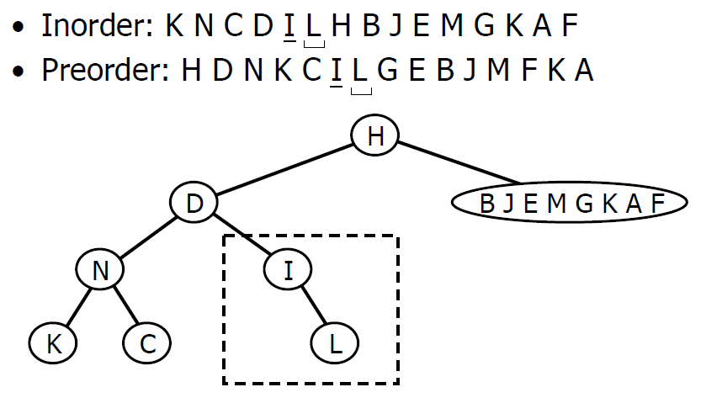
Binary Tree Reconstruction

Slide 11
Binary Tree Reconstruction
Key steps:
Find the root
Find the left and right subtrees and do it recursively
Given both inorder and postorder traversals (or preorder and inorder traversals), the methods are similar.

Slide 12
Binary Search Tree
6
6
2
8
3
9
1
4
1
5
3
4
7
A binary search Tree
Not a binary search Tree
(where is the problem?)

Slide 13
Find Inorder Successor in BST
How to find the inorder successor of a node in BST?
How many cases we have?
2: 3
4: 5
6: 7
3: 4
5: 6
8: 9
6
4
9
2
5
8
10
1
3
7

Slide 14
Find Inorder Successor in BST
6
Two cases!
Minimum of right subtree
2: 3
4: 5
6: 7
Lowest ancestor whose left child is also an ancestor
3: 4
5: 6
8: 9
Question: which node will fail in the both cases?
4
9
2
5
8
10
1
3
7

Slide 15
Find Inorder Successor in BST
For our current implementation of bstCDT, is the information enough for finding a successor?
Class bstCDT:
root: treeNodeADT
left: bstADT
right: bstADT

Slide 16
Exercise 2
Implement the following function
The definition of bstCDT is as follows
Func FindSuccessor(bstADT n)
Class bstCDT:
root: treeNodeADT
left: bstADT
right: bstADT
parent: bstADT

Slide 17
Exercise 2 Solution
Func FindSuccessor(bstADT n):
if n.right != None:
// go to right subtree
n = n.right;
while n.left != None:
n = n.left
return n
else
// trace back to ancestors
p = n.parent
while p != None and p.left != n:
n = p
p = n.parent
return p

Slide 18
More practices
https://leetcode.com/tag/tree/
https://leetcode.com/problems/binary-tree-inorder-traversal/#/description
https://leetcode.com/problems/construct-binary-tree-from-preorder-and-inorder-traversal/#/description

Slide 19
Midterm 2 Time & Scope
The second mid-term exam will be held on Mar 23 (Monday), 2026, from 2:30pm to 3:50pm (Hong Kong time)
The coverage of mid-term exam 2 includes Lists, Complexity Analysis, Selection Sort, Merge Sort, Quick Sort, and BST (but not balanced BST).

Slide 20
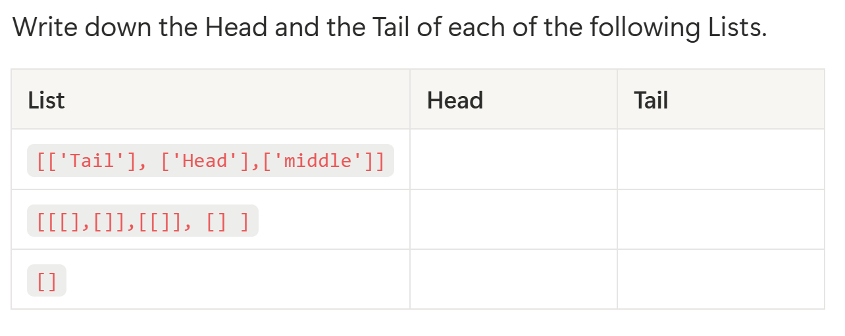
List

Slide 21
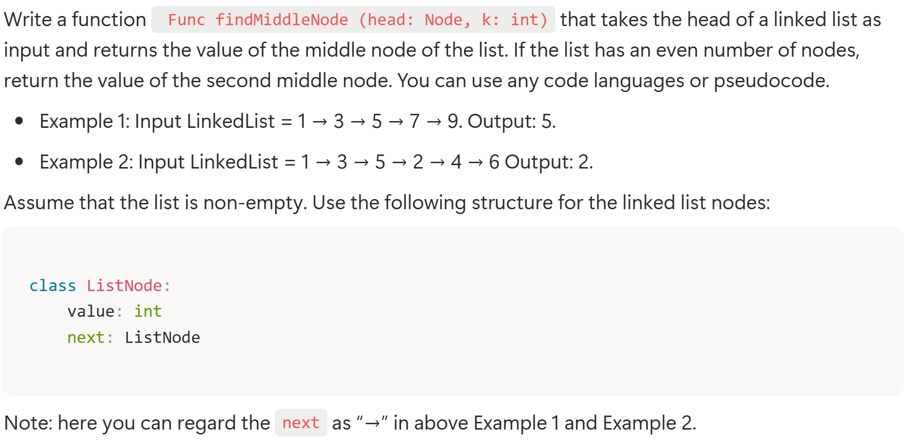
List

Slide 22
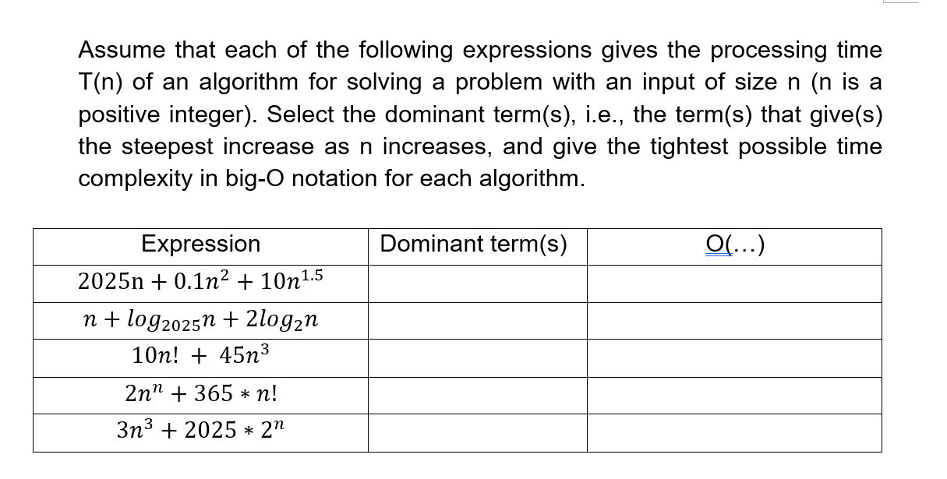
Complexity Analysis

Slide 23
Complexity Analysis
Write down the time complexity for each of the following functions. Express your answers using the big-O notation in terms of the input size and give the tightest possible time complexity.
Func f(n: int)
sum = 0;
for i = 1 to n:
for j = i to n:
sum = sum + j
j = j + i
i = i + 1
return sum
Func f(n: int)
if n == 0 then
return 0
sum = f(n - 1)
for i = 1 to n:
for j = 1 to i:
sum = sum + (i * j)
return sum

Slide 24
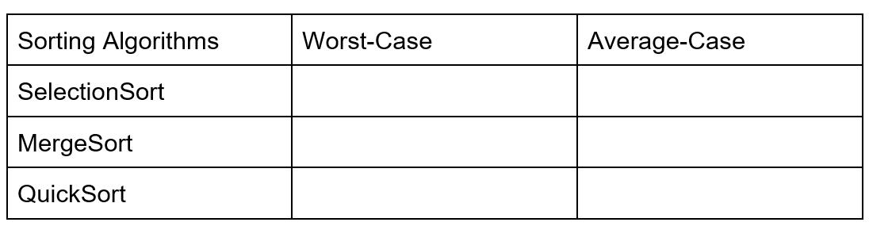
Sorting Algorithms
For each of the three sorting algorithms below, give its time complexity in the worst case and in the average case when the algorithms run on an input of n numbers. Your answers should be in the big-O notation in terms of the input size n and should be as tight as possible. The average should be the average calculated when all the possible n! inputs are equally likely.

Slide 25
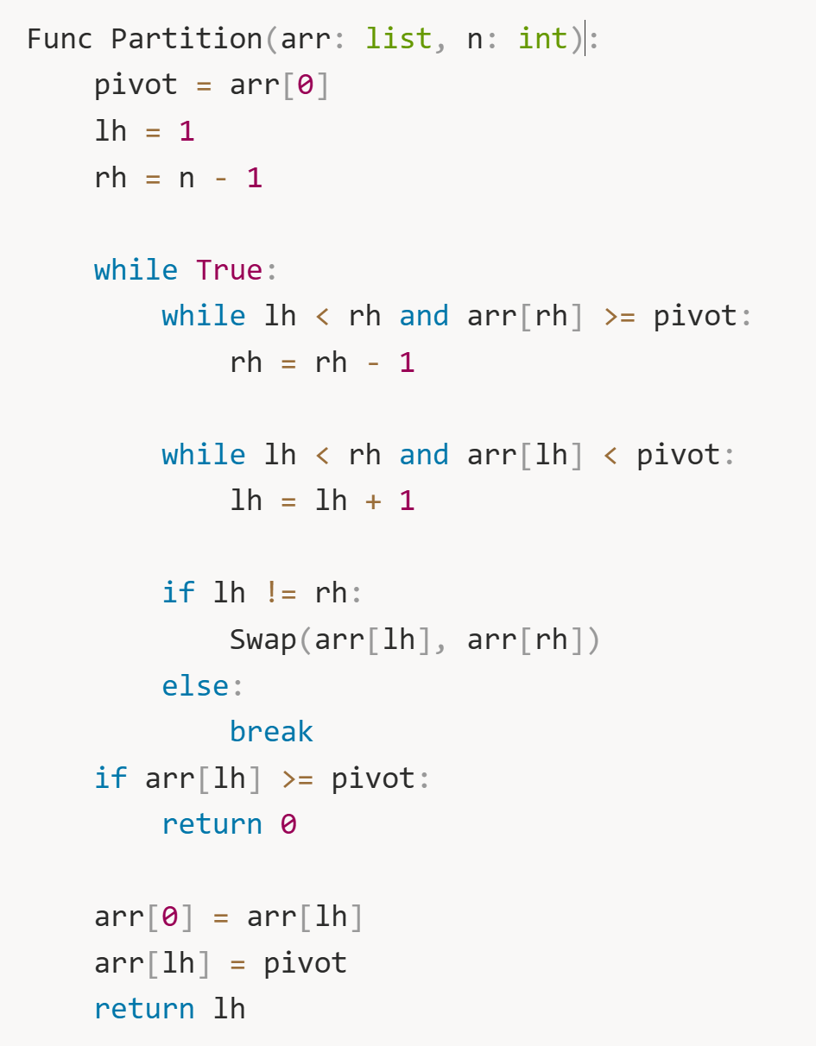
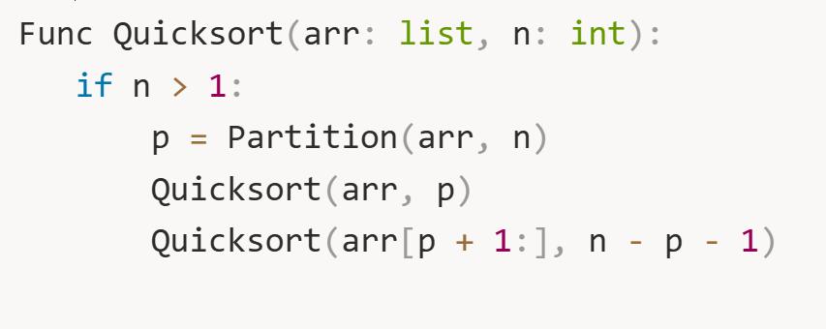
Sorting Algorithms
Given the MergeSort and QuickSort code below.

Slide 26
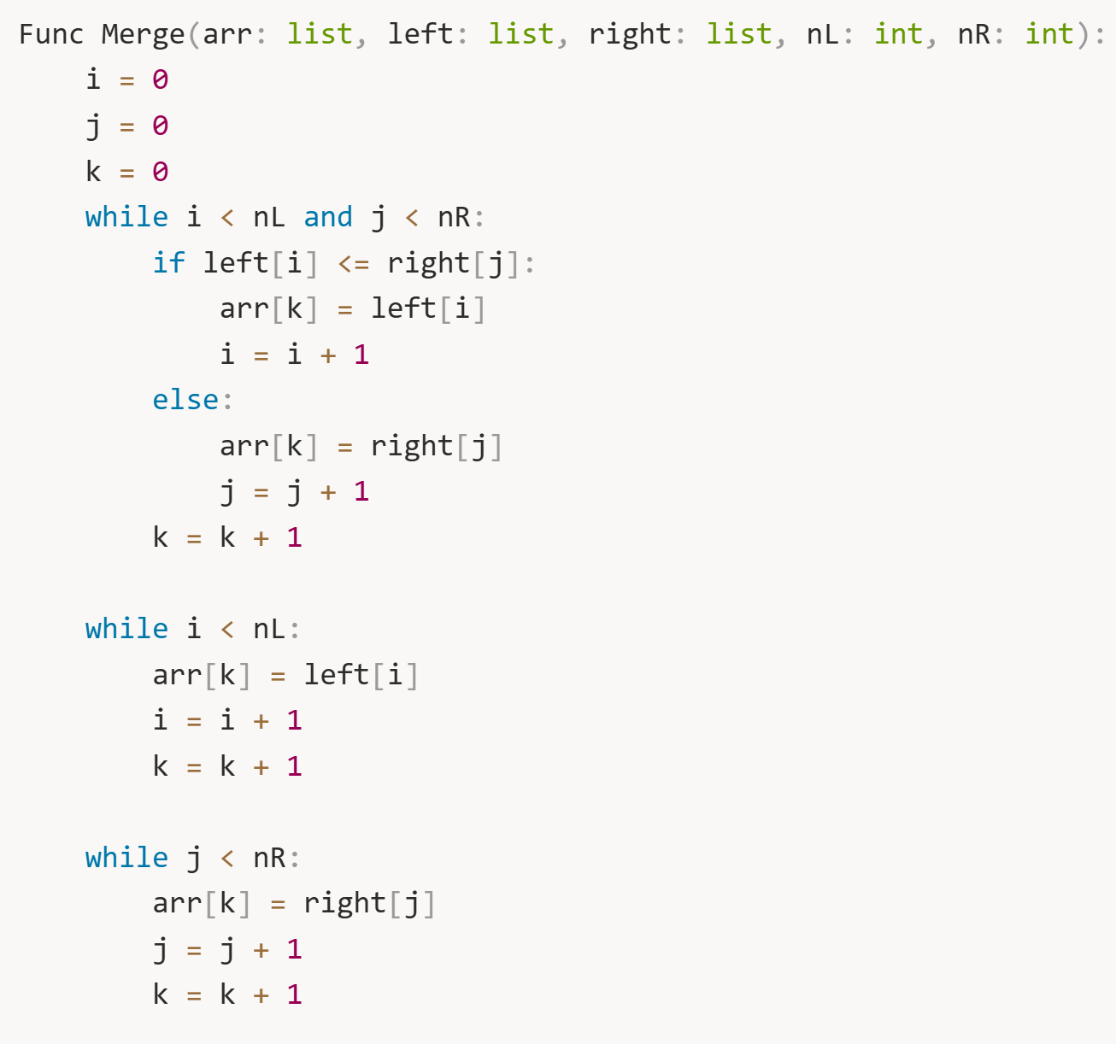
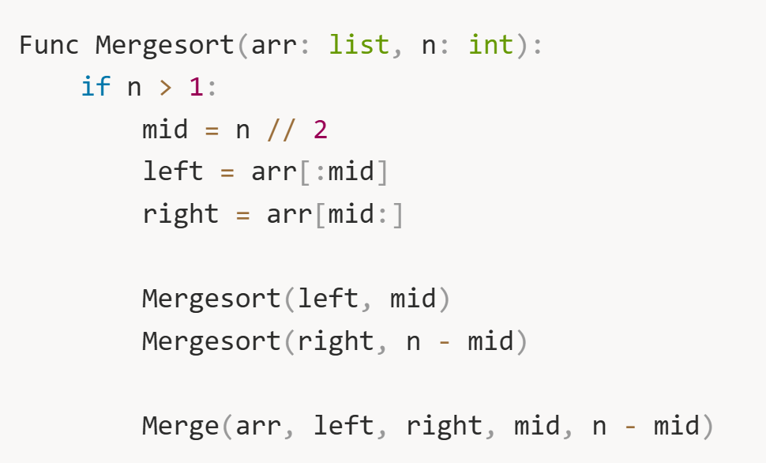
Sorting Algorithms
Given the MergeSort and QuickSort code below.

Slide 27
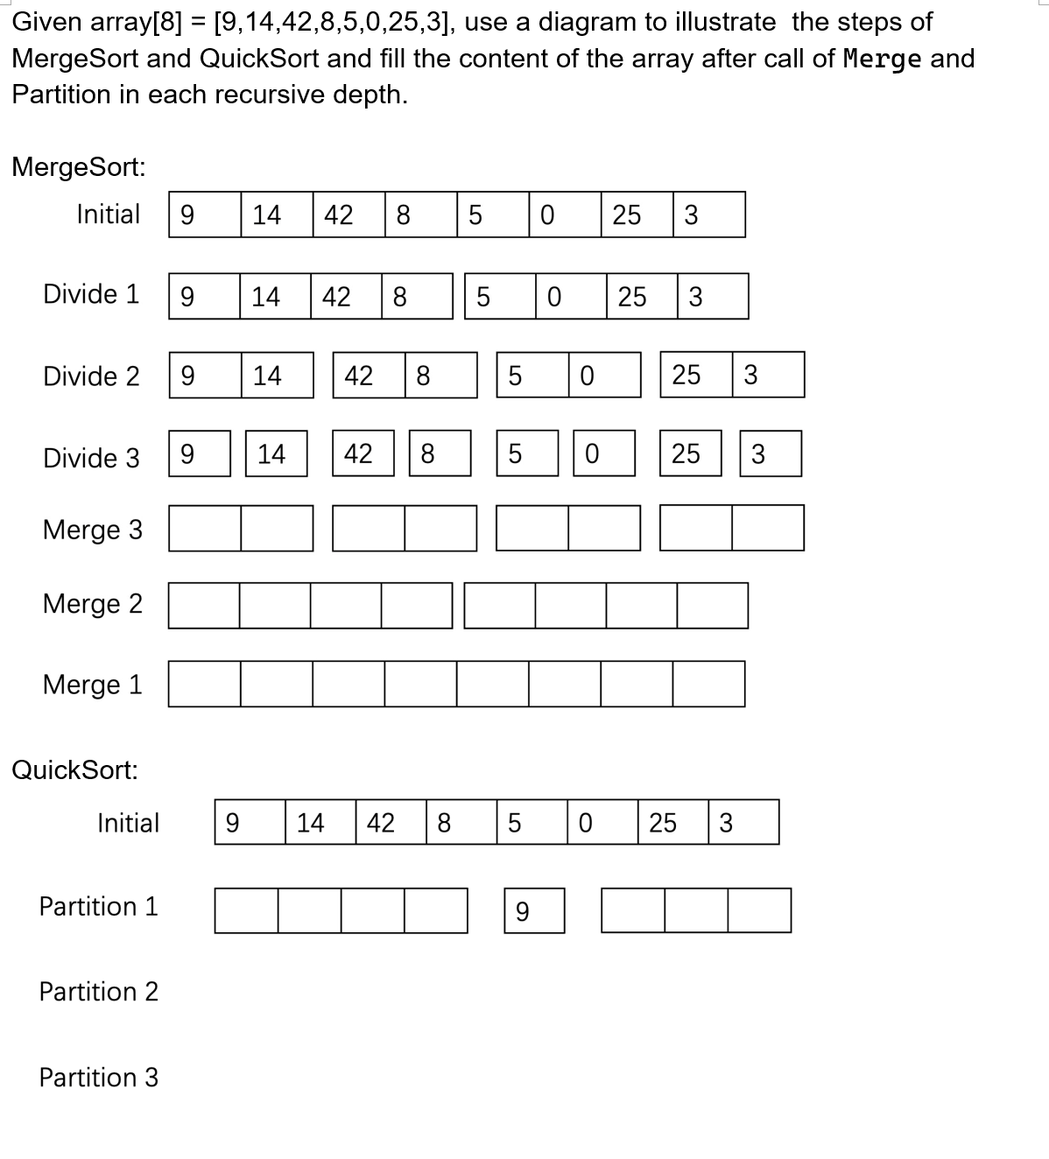
Sorting Algorithms

Slide 28
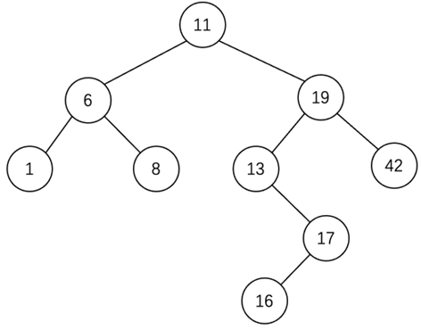
BST
Given a sequence of numbers: 11, 6, 8, 19, 1, 13, 17, 42, 16. We now draw a tree by inserting the above numbers from left to right following the rules: the left child is smaller than the root, the root is smaller than the right child.
According to the lecture, when deleting a node that has two children, there are actually two different strategies, i.e., 1)choosing the node with the maximum key from the left subtree or 2) the node with the minimum key from the right subtree. Show the results of both the strategy after the deletion of 19.

Slide 29
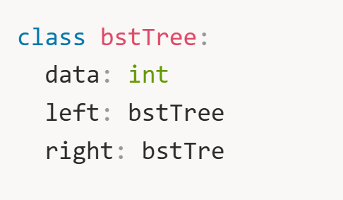
BST
Given an algorithm that returns the node with the k-th biggest key in a binary search tree. The details of how you traverse the tree should be provided.
The BST is defined as follows:

